Slide 1
BV
Getting Started
Retailing
= Weekly income

Slide 2
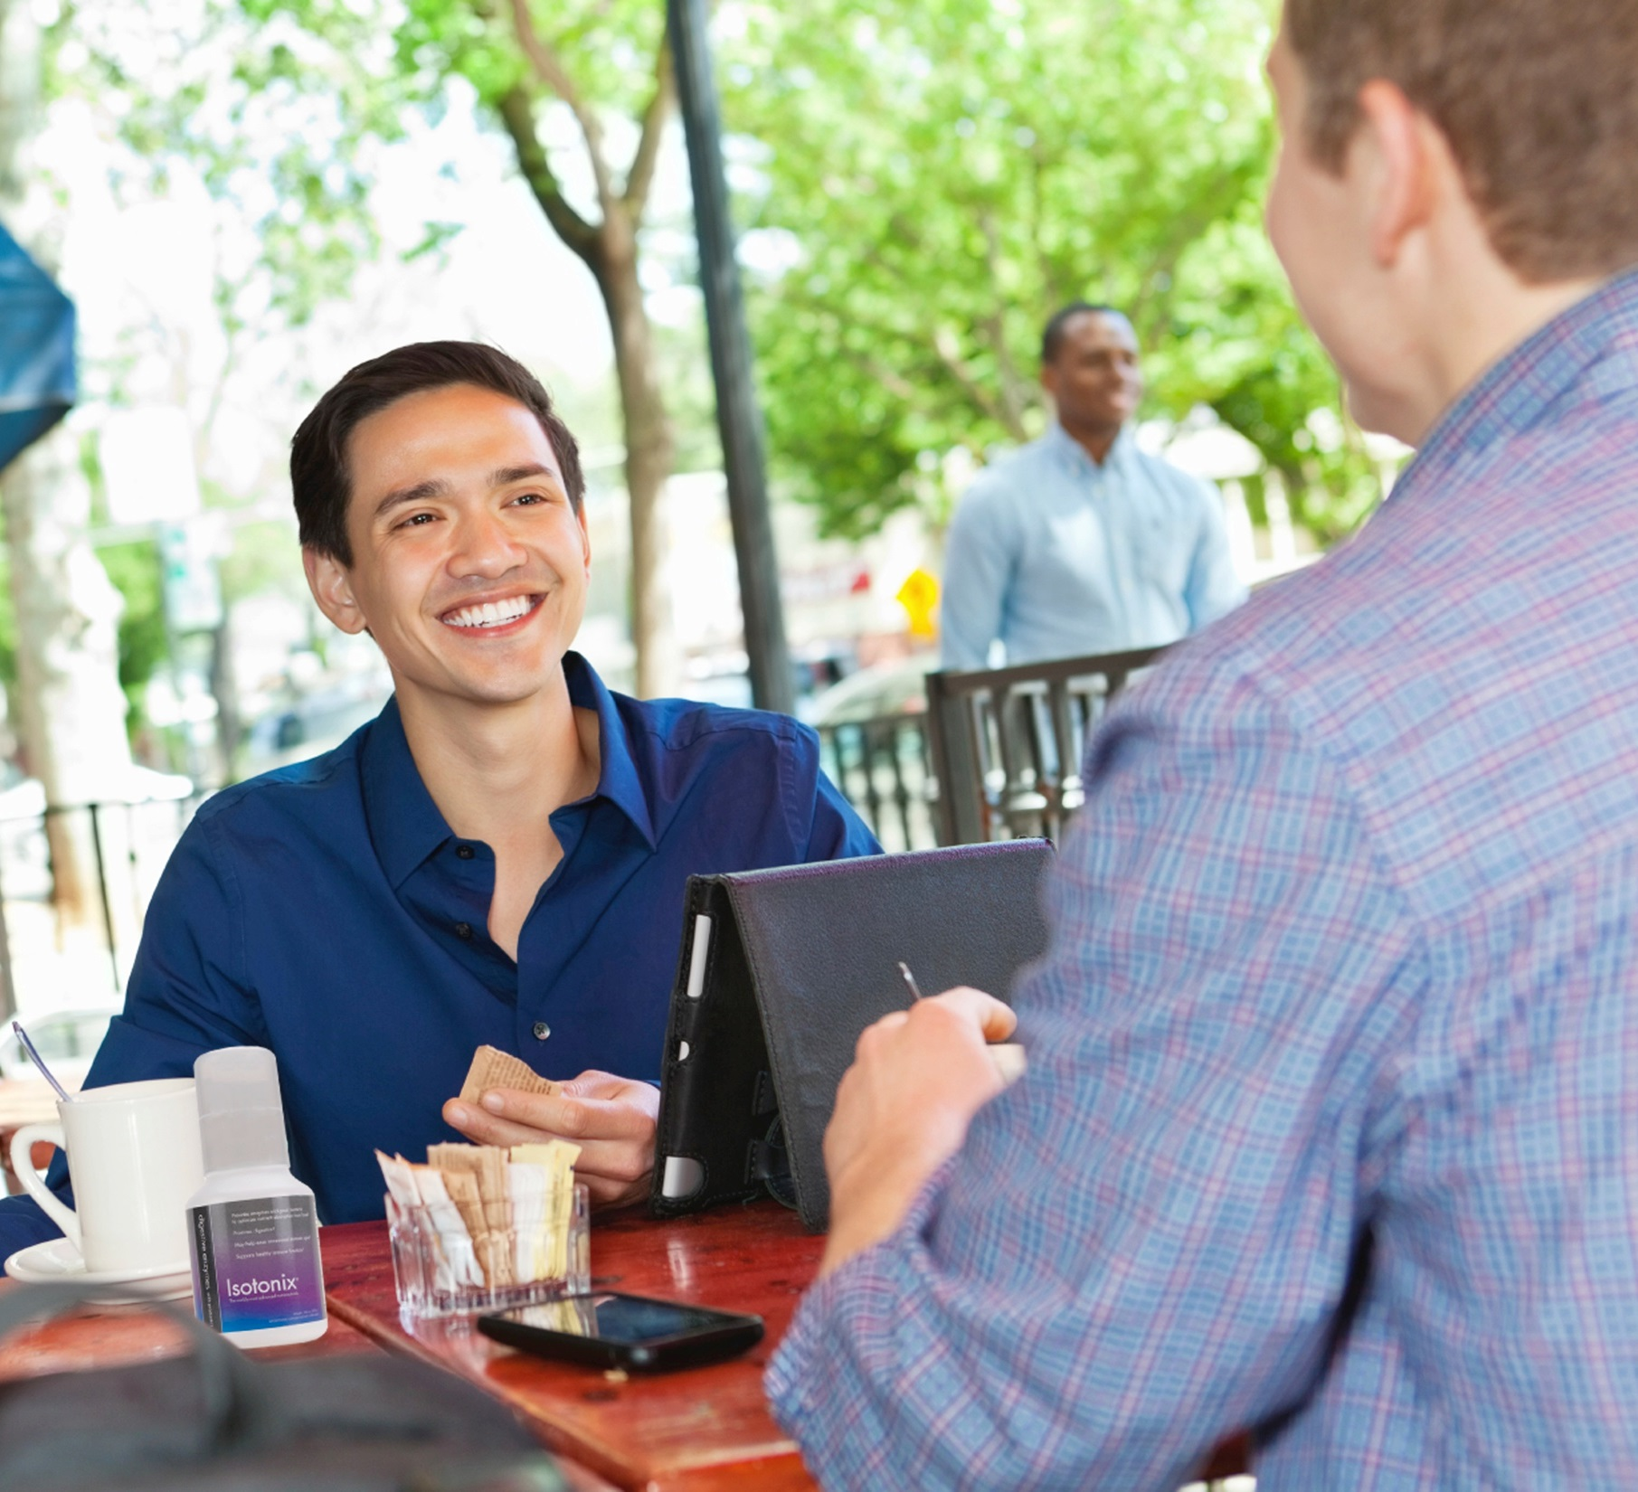
Retailing Builds Your Business
Profit
Replaces start up expenses
Covers monthly overhead expenses
Creates positive cash flow
Generates ongoing Business Volume
Identifies potential business prospects
Builds belief

Slide 3
Retail Sales Goal
Monthly Goal for new UnFranchise® Owner is to generate 200 BV and 20 IBV from personal use and
300 BV and 200 IBV to a base of at least 10 Preferred Customers ordering 30 BV and 20 IBV per month
PC -
PC -
PC -
PC -
PC -
- PC
- PC
- PC
- PC
- PC
PC = 30 BV and 20 IBV
Total UnFranchise Owner Production: 500 BV and 220 IBV

Slide 4
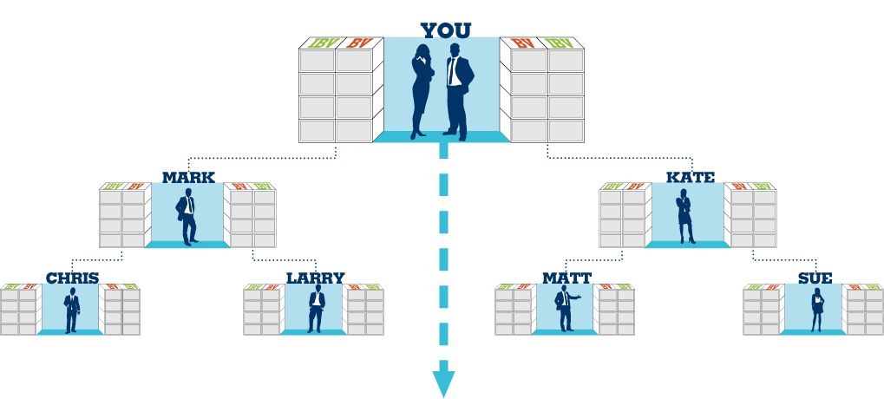
Retail Sales Goal - Base 10, Seven Strong
Seven UFOs With 10 Pcs each
Each UFO creates 500 BV and 200 IBV Monthly (Personal Use and PCs)
Commissions = $300/Monthly (BV) and $300 every 2nd month (IBV)
1500 BV & 600 IBV
1500 BV & 600 IBV
5 PCs
5 PCs
500 BV & 200 IBV Volume can be placed
5 PCs
5 PCs
5 PCs
5 PCs
500 BV & 200 IBV
500 BV & 200 IBV
5 PCs
5 PCs
5 PCs
5 PCs
5 PCs
5 PCs
5 PCs
5 PCs
500 BV & 200 IBV
500 BV & 200 IBV
500 BV & 200 IBV
500 BV & 200 IBV
BV and IBV banks on this slide display weekly volume accruals

Slide 5
Minimum Activity
Power of Your Actions
50 BV and 10 IBV monthly per UFO
Monthly Goal and Base 10
200 BV and 20 IBV monthly per UFO
300 BV and 200 IBV to 10 Preferred Customers per UFO (30/20 each)
Shopping Annuity® and Base 10
500 BV and 200 IBV monthly per UFO
300 BV and 200 IBV to 10 Preferred Customers per UFO (30/20 each)

Slide 6
Organization Satisfying the Minimum Activity Requirements
Commissions = $600 monthly (BV) and $300 every third month (IBV)
Minimum Activity Requirements 50 BV + 10 IBV monthly per UFO
Total = 50 BV + 10 IBV per UFO
You should earn $300 - $600 every other week (BV) and $300 every third month (IBV)
50 UFO’s x 50 BV = 2,500 BV Monthly
Plus
50 UFO’s x 10 IBV = 500 IBV Monthly
50 UFO’s x 50 BV = 2,500 BV Monthly
Plus
50 UFO’s x 10 IBV = 500 IBV Monthly
BV and IBV banks on this slide display weekly volume accruals

Slide 7
Organization Satisfying the Monthly Goal and base 10
Commissions = $6,000 monthly (BV) and $3,000 monthly (IBV)
Monthly Goal 200 BV + 20 IBV monthly per UFO
Base 10 300 BV + 200 IBV from 10 PCs per UFO
Total = 500 BV + 220 IBV per UFO
You should earn $1500 weekly (BV) and $1500 every other week (IBV)
50 UFO’s x 500 BV = 25,000 BV Monthly
Plus
50 UFO’s x 200 IBV = 10,000 IBV Monthly
50 UFO’s x 500 BV = 25,000 BV Monthly
Plus
50 UFO’s x 200 IBV = 10,000 IBV Monthly
BV and IBV banks on this slide display weekly volume accruals

Slide 8
Organization Satisfying the Shopping Annuity® and base 10
Commissions = $8,400 monthly (BV) and $6,000 monthly (IBV)
Shopping Annuity 500 BV + 200 IBV monthly per UFO
Base 10 300 BV + 200 IBV from 10 PCs per UFO
Total = 800 BV + 400 IBV per UFO
You should earn $2100 weekly (BV) and $1500 weekly (IBV)
50 UFO’s x 800 BV = 40,000 BV Monthly
Plus
50 UFO’s x 400 IBV = 20,000 IBV Monthly
50 UFO’s x 800 BV = 40,000 BV Monthly
Plus
50 UFO’s x 400 IBV = 20,000 IBV Monthly
BV and IBV banks on this slide display weekly volume accruals

Slide 9
Objectives of Retailing
Create your Shopping Annuity
Develop a 10-15 repeat customers who purchase ≥ 30 BV/20 IBV monthly
Building share of customer
Retail to recruit, leads to commissions

Slide 10
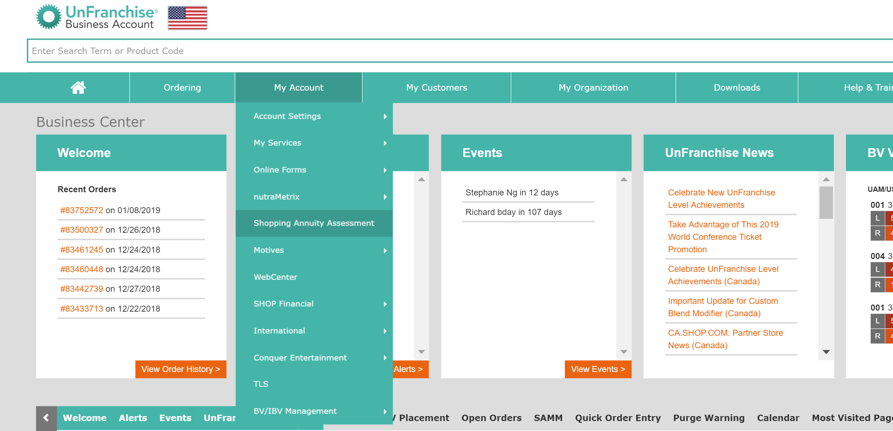
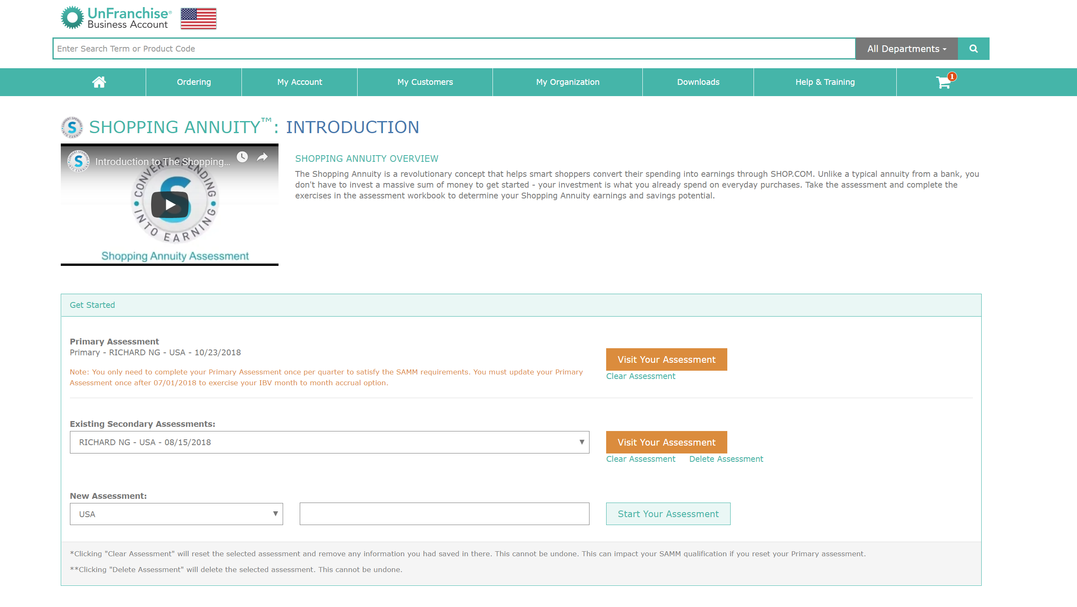
Create your Shopping Annuity

Slide 11
New UFO Launch
2 Product events
In between & On Going Promotion
Trail Size Marketing
Information Marketing
Attraction Marketing
Develop a 10-15 repeat customers who purchase ≥ 30 BV/20 IBV monthly

Slide 12
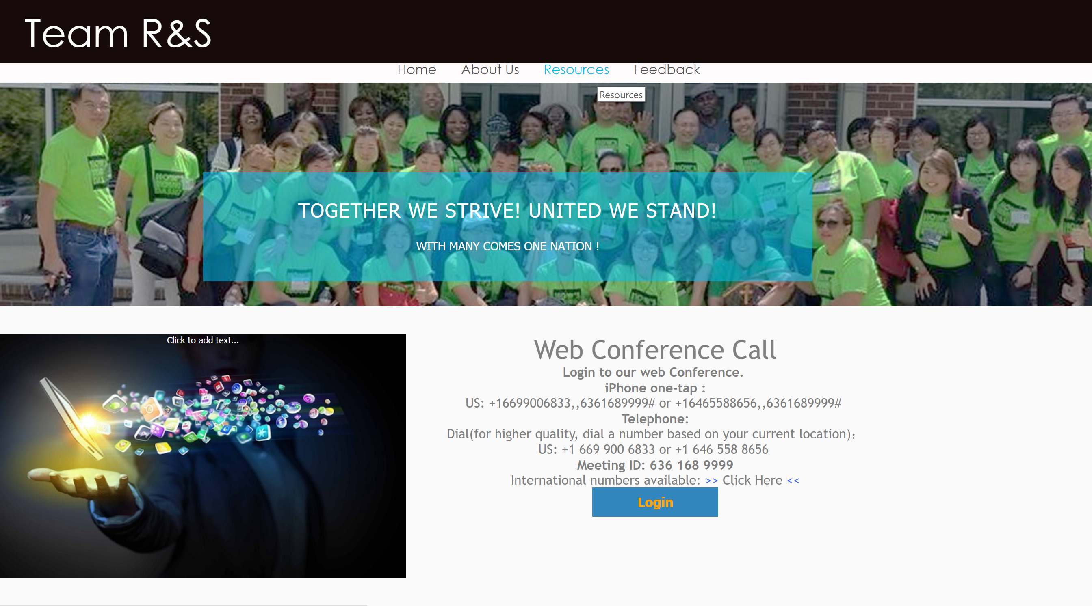
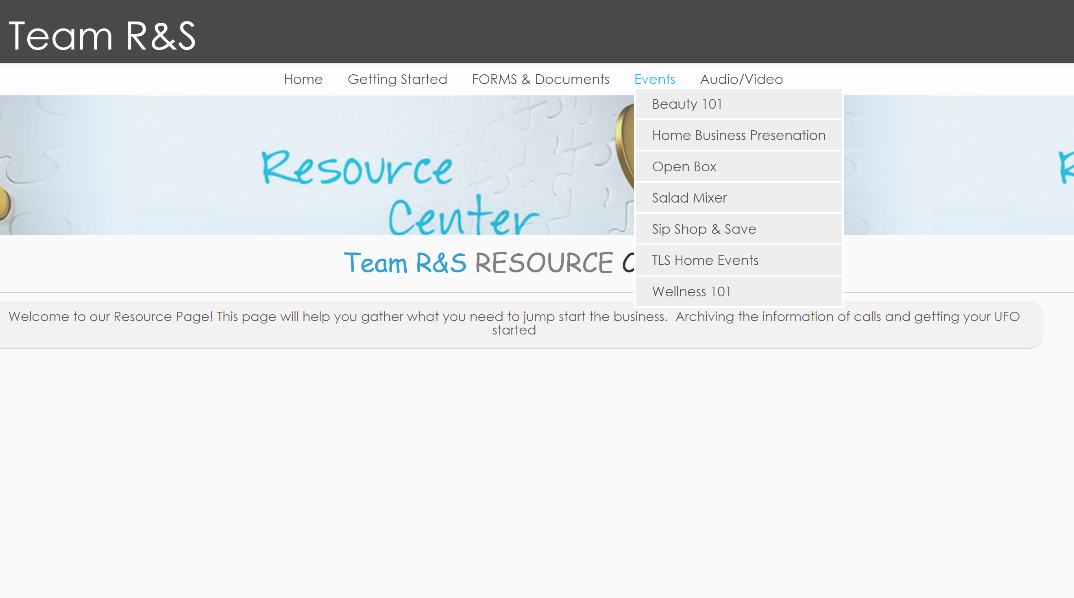
Product Events

Slide 13
Product Event Concept
Retail to Recruit
Introduce a glimpse of what the company have
Testimonials
Information sharing

Slide 14
The Design of a product event
Mix and Mingle & Survey completion
Welcome
Introduce Shop.com
Share Testimonial
Share Infroamtion : Video/Presentation
Q&A
Close

Slide 15
Trail Size Marketing
Concept: Sample to retail
Steps 1 Request to sample products
Steps 2
Set the Condition
Steps 3
Follow up
Steps 4
Close

Slide 16
Informational Marketing
Set up An Album of Testimonials
Save Information on :
OPC Clinical Studies
Manufacturer Quality
Product Reference Audio

Slide 17
Attraction Marketing
Social Media Base
Share lifestyle
Post Daily – once to 3x daily
Comments 5 post daily
Using Social Media to Increase Social Currency

Slide 18
Key Is in the follow-up:
Precision in follow gives long term customer
Create a Prefer Customer Program to service them
Leverage new product Launch, customer appreciation day or Product call, and facebook customer page.
Follow up Pointers Day 1: Touch Base: Day 1 Day 3: Verification
Day 5: Confirmation
Day 7: : Follow through & building a relationship
Day 14:Just in Case
Day 21: Reorder
Building share of customer

Slide 19
ASK For The Sale
Some Example
If I could Show you a way …. Is there any reason you wont more information/ try the products?
Let me put them in a bag, it is $XX
How would you like to get started

Slide 20
Consistency is the Key. Eat the Elephant one bite at the time. Momentum sheet will help focus.

Slide 21
Keys of Retailing
Transfer your buying habits with UnFranchise AutoShip. Be a product of the product (you will sell what you use)
Develop a possibility list for potential customers for each product line (background info). Matching products to people and people to products
Tell your story (stories sell product)
Collect and use testimonials
Obtain and provide literature

Slide 22
Keys of Retailing
Build relationships
People hate to be sold but love to buy
Obtain knowledge about your product
Training, videos, UnFranchise account, SHOP.COM, University Major concept
Implement a follow up system
Build share of customer
Lifetime customer value

Slide 23
BV
Getting Started
Retailing
= Weekly income

